Slide 1
eCourse Progress Report – Sprint C
Date: 19/06/2023
Team/Students:
1201305 - Tiago Afonso
1211171 – Pedro Mesquita
1211250 – Luís Monteiro
1201078 – Miguel Marques

Slide 2
Completed Activities
ID | Description | Responsable | Baseline | Real | Estado
1008 | As Student, I want to request my enrollment in a course | Pedro Mesquita - 1211171 |  | Start: 28-06-2023 End: 08-06-2023 | ✓
1009 | As Manager, I want to approve or reject students applications to courses | Pedro Mesquita - 1211171 |  | Start: 28-06-2023 End: 08-06-2023 | ✓
2002 | As Student, I want to view a list of my future exams | Pedro Mesquita - 1211171 |  | Start: 16-06-2023 End: 16-06-2023 | ✓
2003 | As Teacher, I want to view a list of all exams in a course | Pedro Mesquita - 1211171 |  | Start: 18-06-2023 End: 18-06-2023 | ✓
2006 | As Teacher, I want to view a list of the grades of exams of my courses. | Pedro Mesquita - 1211171 |  | Start: 17-06-2023 End: 18-06-2023 | ✓
3001 | As Project Manager, I want the team to prepare the communication infrastruture for the Shared Boards and the depoyment of the solution | Luís Monteiro – 1211250 Miguel Marques - 1201078 |  | Start: 01-06-2023 End: 08-06-2023 | ✓
3002 | As User, I want to create a board | Pedro Mesquita – 1211171 Luís Monteiro - 1211250 |  | Start: 10-06-2023 End: 16-06-2023 | ✓
3003 | As Project Manager, I want the team to "explore" the synchronization problems related to the shyncronization of shared boards and design a conceptual solution based on practical evidence. | Pedro Mesquita – 1211171 Miguel Marques - 1201078 |  | Start: 15-05-2023 End: 20-05-2023 | ✓

Slide 3
Completed Activities
ID | Description | Responsable | Baseline | Real | Estado
3004 | As User, I want to share a board. | Pedro Mesquita - 1211171 |  | Start: 15-06-2023 End: 16-06-2023 | ✓
3005 | As User, I want to view, in real-time, the updates in the shared boards. | Luís Monteiro – 1211250 Miguel Marques - 1201078 |  | Start: 15-06-2023 End: 18-06-2023 | ✓
3006 | As User, I want to create a post-it on a board. | Luís Monteiro – 1211250 |  | Start: 13-06-2023 End: 18-06-2023 | ✓
3007 | As User, I want to change a post-it. | Luís Monteiro – 1211250 Miguel Marques - 1201078 |  | Start: 13-06-2023 End: 18-06-2023 | ✓
3008 | As User, I want to undo the last change in a post-it. | Luís Monteiro – 1211250 Miguel Marques - 1201078 |  | Start: 13-06-2023 End: 18-06-2023 | ✓
3009 | As User, I want to view the history of updates on a board. | Miguel Marques - 1201078 |  | Start: 28-06-2023 End: 17-06-2023 | ✓
5002 | As Software Product Client, I want the team to prepare this presentation. | Everyone |  | Start: 01-06-2023 End: 18-06-2023 | ✓
 |  |  |  |  | ✓

Slide 4
Activities Uncompleted/To Be Started
ID | Atividade | Responsável | Baseline | Real | Estado
2001 | As Teacher, I want to create/update an exam | 1201305 - Tiago Afonso | Start: 11-04-2023 End: 22-04-2023 | Start: 19-09-2020 End: | ●
2004 | As Student, I want to take an exam | João Torres |  |  | ●
2005 | As Student, I want to view a list of my grades | 1201305 - Tiago Afonso | Start: 05-06-2023 End: 06-06-2023 | Start: N/A End: N/A | ●

Slide 5

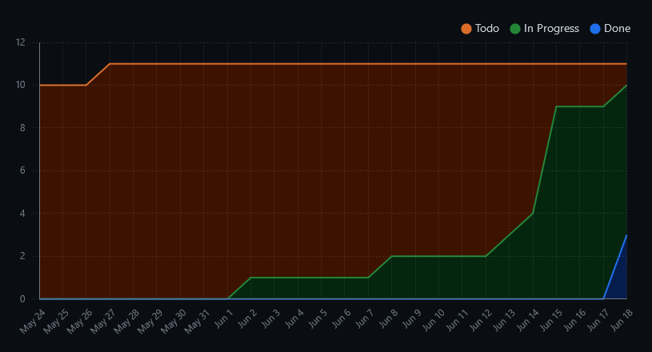
Burn up / CFD

Slide 6
Main objectives of the system
The system supports remote learning, providing a solution for teachers, students, and managers to engage in learning activities regardless of their location.
It includes automated exams with instant feedback and grades, shared boards for collaboration, and aims to yield high-value results.
The platform caters to teachers, students, and managers, enhancing their experience in remote learning.

Slide 7
Adopted development process and planning
Scrum framework for iterative development
GitHub repository for code organization and issue tracking
GitHub project board for task management
Sprint planning sessions for task prioritization
Visual representation of progress on the project board
Collaboration, transparency, and efficient delivery achieved through Scum and GitHub.

Slide 8
Teamwork methodology and conflict resolution strategy
Teamwork Methodology:
Collaboration
Set common goals
Estabilish responsibilities for each team member
Conflict Resolution Strategy:
Encourage constructive discussions to understand diferent POVs
Implement fair decision-making process

Slide 9
Product Quality
When all said is done, we believe we did a good effort to capture and implement almost everything that was meant to be done.
Due to one of the members not being present, the exams part of the application was not as good as expected, not having the propper grammar validation.
Other side that could also be better with more time would be the boards, which are not completely imported to the server.
In total, we rank our product 4/5 stars.

Slide 10
Expected Results
As a team, we had our ups and downs in this project, one of our members was only having two courses and still ended up not doing anything and other was interned and dropped out. With that, our expectations dropped but we still kept our head high and kept working.
Our expected result was a fully functiontal project with all the functionalities we were asked to implement, however, due to the challenges we faced with team members' lack of contribution and unexpected departures, our final result fell short of our initial expectations.

Slide 11
Lessons Learned
Stop | Start | Continue | Less of | More of
Ineffective communication | Regularly reviewing and updating user stories for clarity | Prioritize and encourage communication among team members | Rushing through user story implementation without clarity | Transparent and open communication
Delaying user stories | Establishing a process for handling carry-over user stories from previous sprints |  | Time allocated for resolving carry-over issues from previous sprints | Active participation in clarifying requirements
 | Daily stand-up meetings for progress updates

Slide 12
eCourse Progress Report – Sprint C
Date: 19/06/2023
Team/Students:
1201305 - Tiago Afonso
1211171 – Pedro Mesquita
1211250 – Luís Monteiro
1201078 – Miguel Marques

